Slide 1
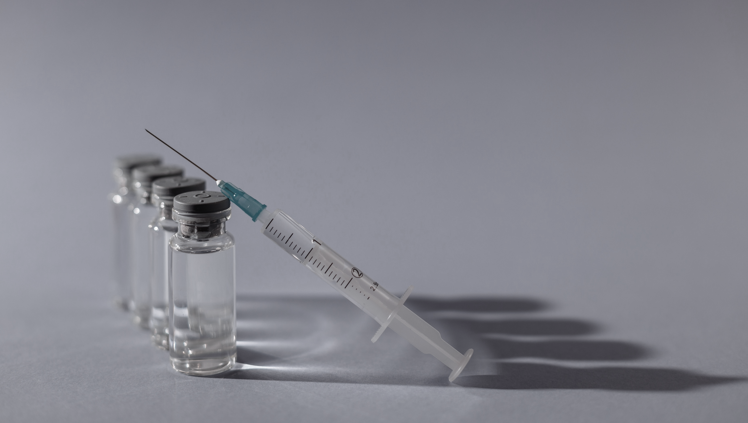

UNDERSTANDING HPV VACCINATION RATES
To eliminate vaccine-preventable HPV cancers
Notes:
Understanding HPV vaccination rates to meet the American Cancer Society’s goal of eliminating vaccine-preventable HPV cancers.

Slide 2
Outline
Why HPV?
Vaccine Status
Mission
The Data
Moving Forward

Slide 3
1.
Why HPV?

Slide 4
43 million infections in 2018
Notes:
With the current incidence rate, it’s estimated that 80% of sexually active adults will get the virus at some point in their lives.
Why does this matter? HPV is linked to:
Genital warts
Cervical, oropharyngeal, and other cancers

Slide 5
2.
Vaccine Status

Slide 6
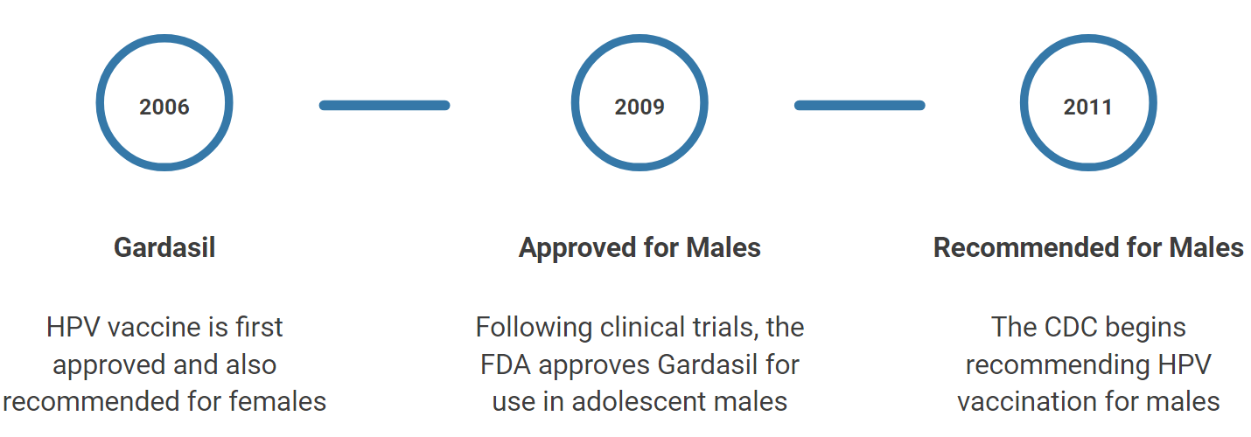
A Brief History
Notes:
Approved in 2006 for females and in 2009 for females. Recommended for adolescents of both genders by the CDC in 2011.
Mandated in DC and 3 states: Hawaii, Rhode Island, Virginia for public school attendance
Albeit with various religious/medical exemptions and gender requirements – e.g., Virginia only requires girls to be vaccinated
Also does not apply to those who are homeschooled or attend private schools.
Note: Hawaii did not have legislation in place by the time this data was collected
Controversy surrounding STD association despite being proven to be extremely safe and effective against cancer-causing serotypes
Tricky population to target (still under parental/guardian care, adolescent to college age population may not have steady access to healthcare)
Studying the effects of these policies, recommendations, and connotations can help us target low vaccination populations

Slide 7
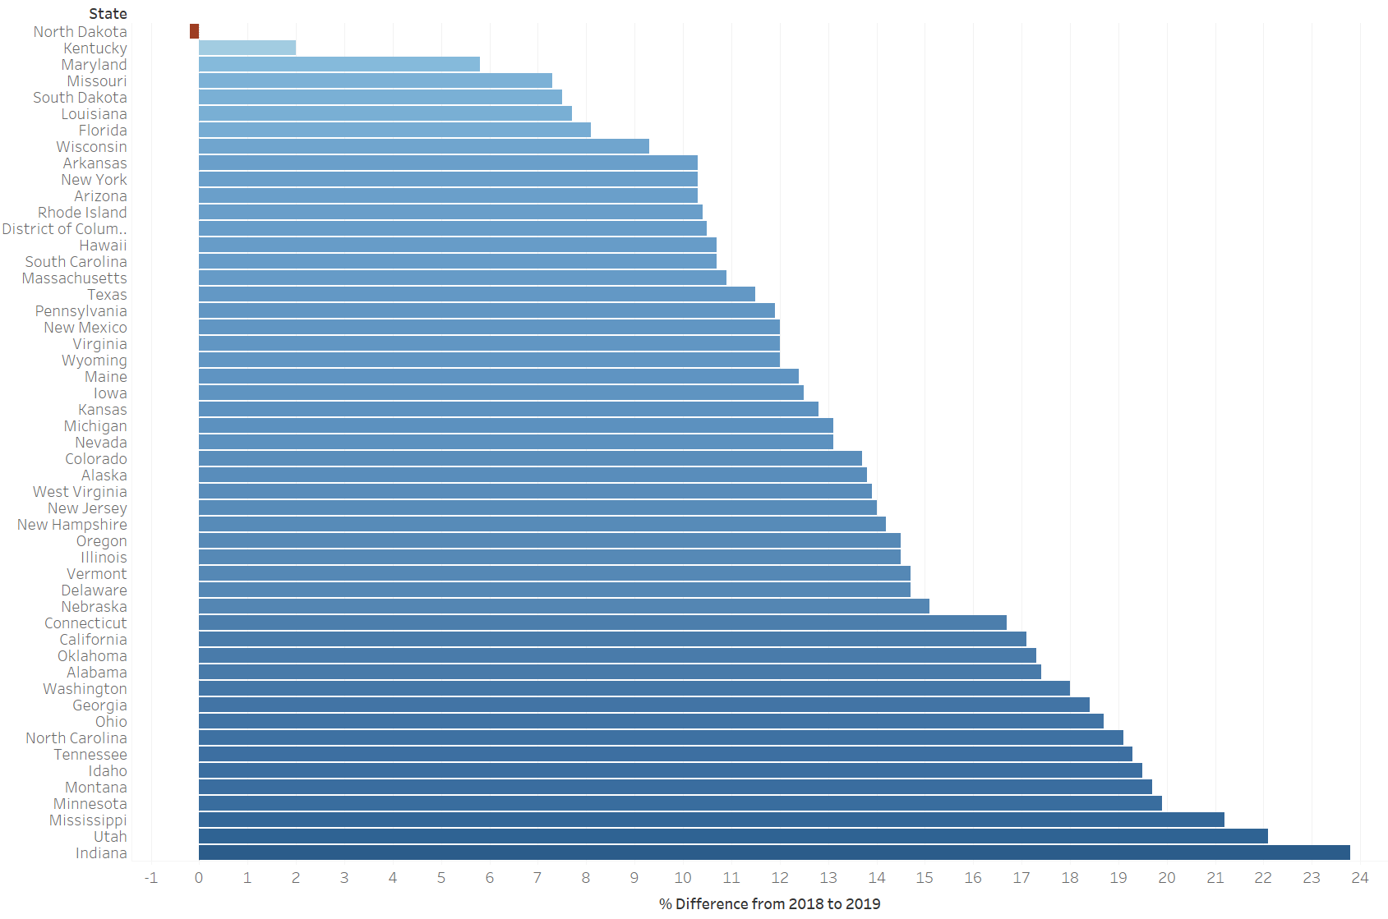
2018-2019 Progress
Notes:
In comparing rates from 2019 to 2018, generally making progress! On average, improved by ~13.5%
Slight decrease in North Dakota, but as we’ll see, it has one of the highest vaccination rates

Slide 8
3.
Mission
Notes:
As a reminder, one of ACS’s initiatives is Mission: HPV Cancer Free

Slide 9
Eliminate vaccine-preventable HPV cancers
Goal: reach an annual vaccination rate of 80% in 13-year-olds in the United States by 2026
Notes:
ACS’s mission of HPV Cancer Free aims to eliminate vaccine-preventable HPV cancers by reaching an annual vaccination rate of 80% in 13-year-olds by 2026.

Slide 10
4.
The Data
Notes:
To reach our goal of increasing vaccination rates, it’s important to analyze the available data to develop tailored interventions. This data comes from the CDC’s 2018 and 2019 Adolescent HPV Vaccination Coverage report.

Slide 11
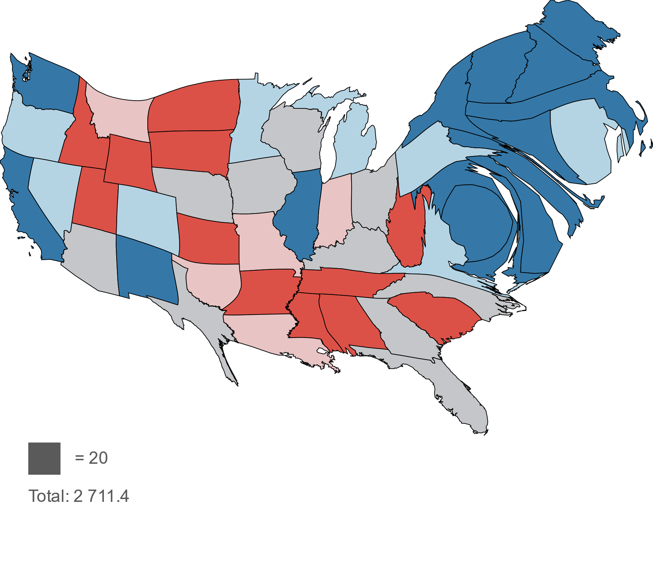
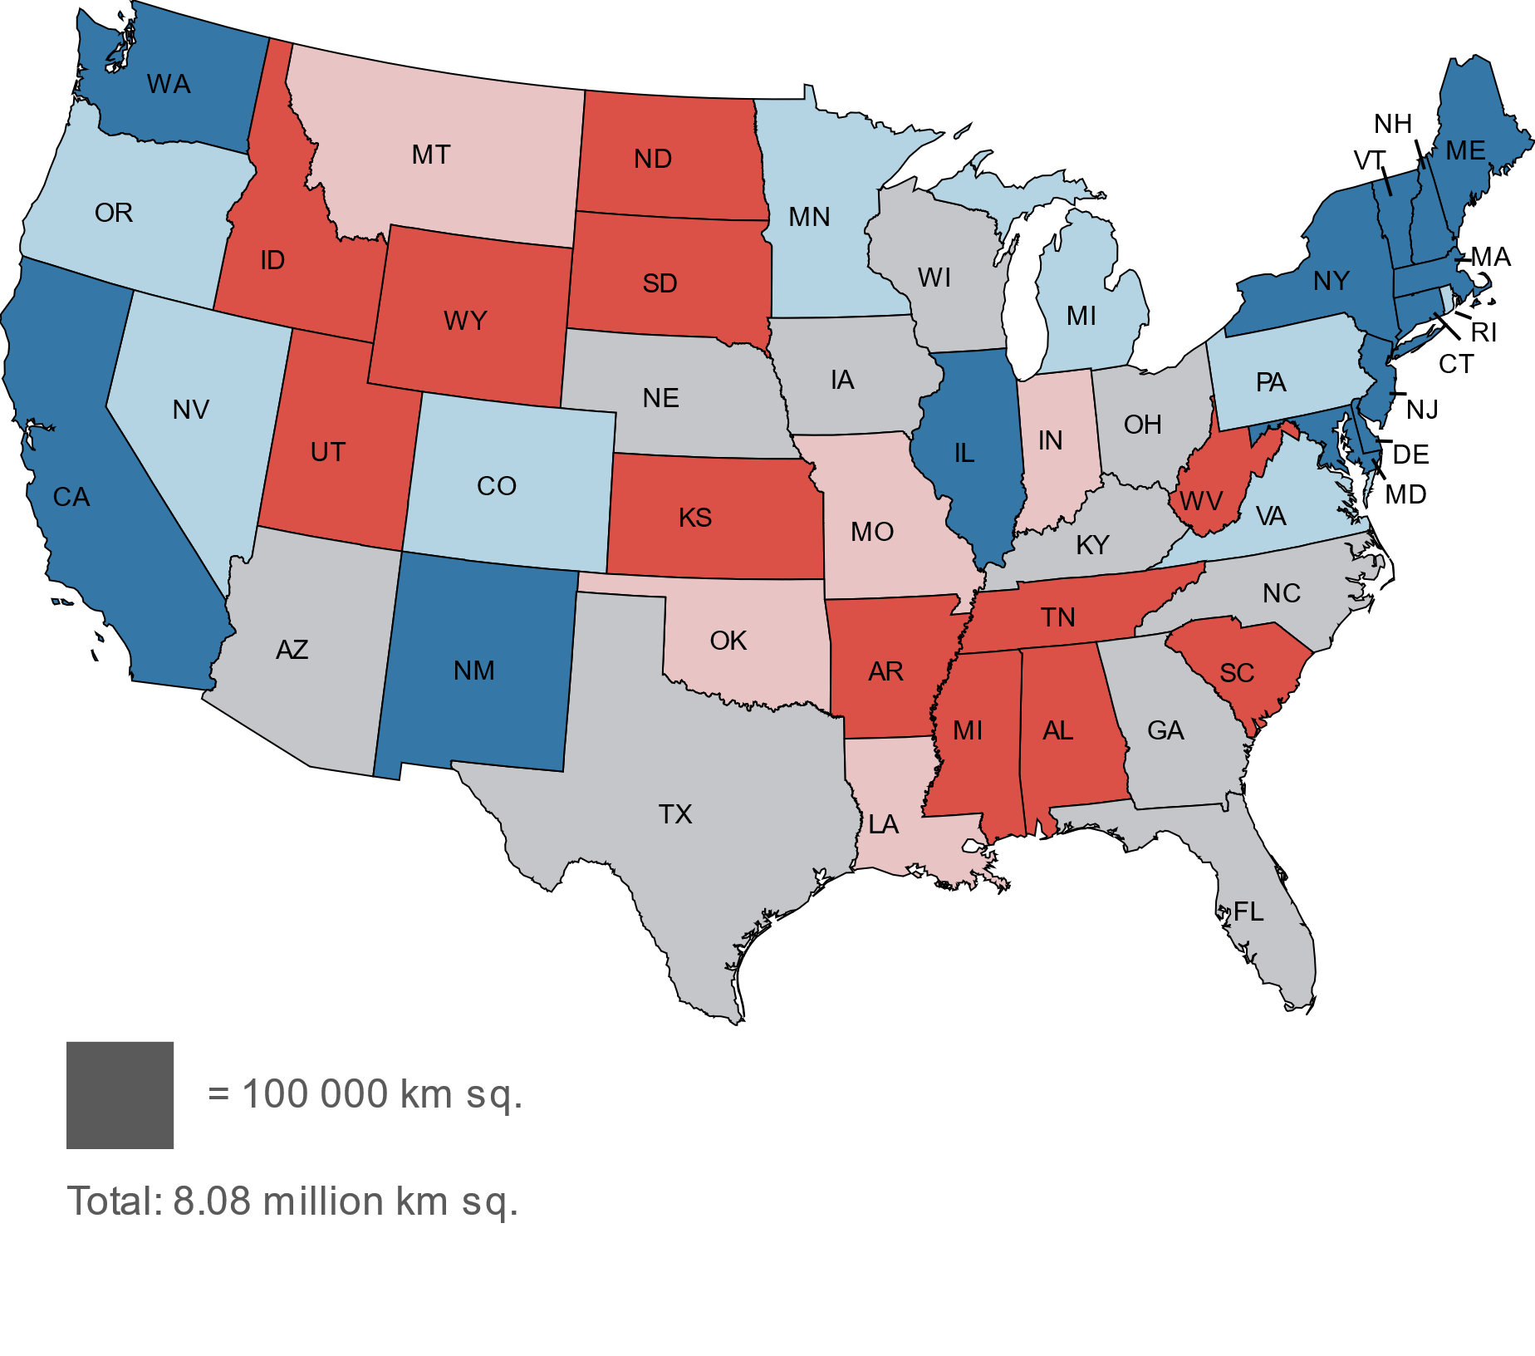
Notes:
Here we can see a map of the contiguous states, shaded by political leaning, which was obtained from Gallup polls.

Slide 12
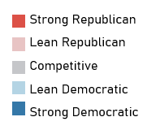
Regional Vaccination Trends
Notes:
And you can see how it transforms to show which regions have the highest rates of HPV vaccination, in particular, the northeast.

Slide 13
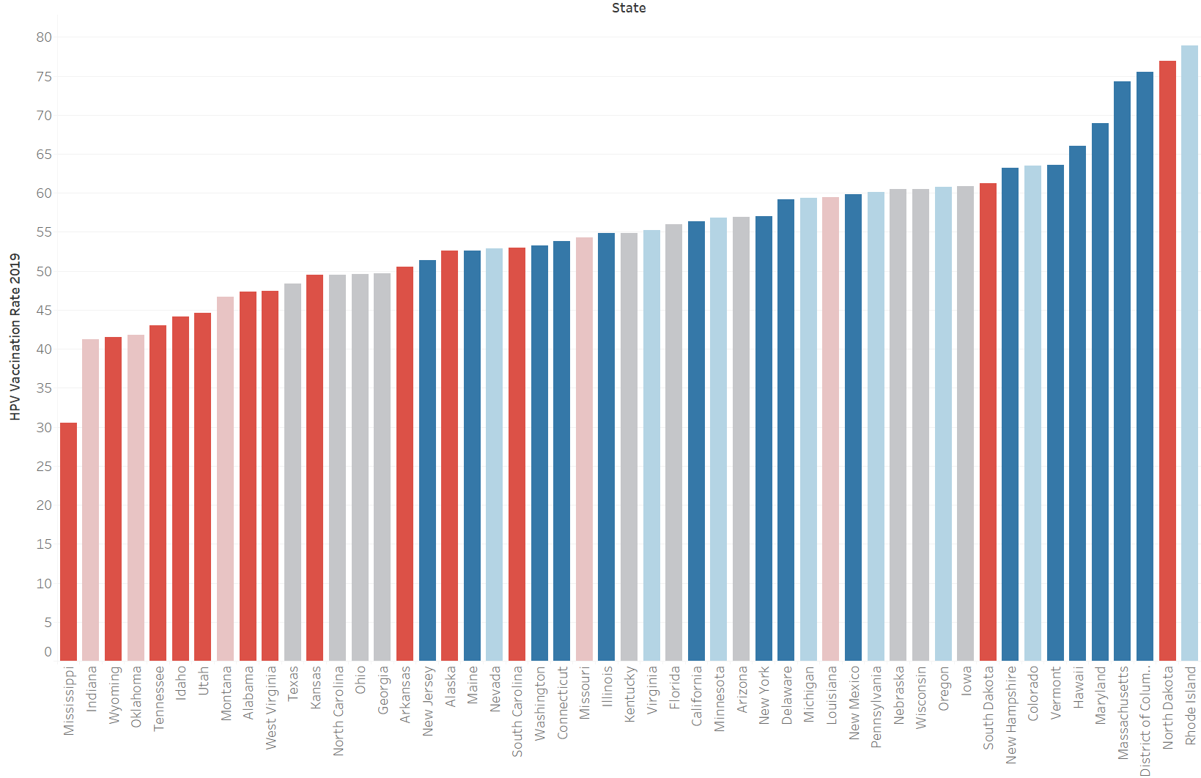
Ranking Vaccination Rates
Notes:
Politically democratic states tend have higher vaccination rates than republican states do. This may tie into the cultural hesitancy surrounding the vaccine and the availability of sex education and related programs in the state (e.g., Planned Parenthood or other clinics that offer the vaccine). One extreme exception to note is North Dakota (second highest vaccination rate in the country despite being strongly republican).

Slide 14
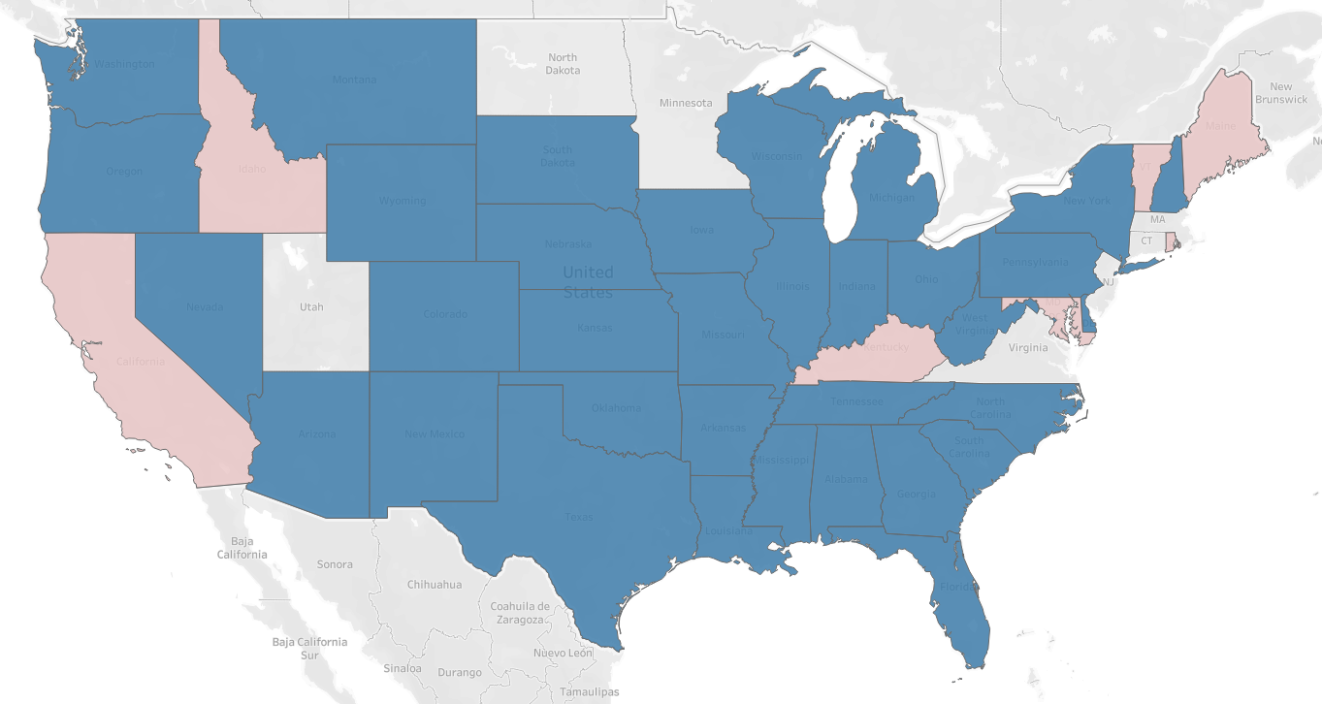
HPV Vaccination Rates by Poverty Status
Below poverty line > Above poverty line
Above poverty line > Below poverty line
* Poverty level data was unavailable for the following states: CT, HI, MA, MN, NJ, ND, UT, VA
Notes:
Perhaps somewhat surprisingly, for most states, vaccination rates are higher for those living below the poverty line as opposed to at or above the poverty line. This is likely due to efforts of Planned Parenthood, Vaccines for Children (VFC), and other cost-reducing programs. This suggests that low vaccination rates are not due to lack of access so much as they are due to other factors such as culture or vaccine hesitancy.

Slide 15
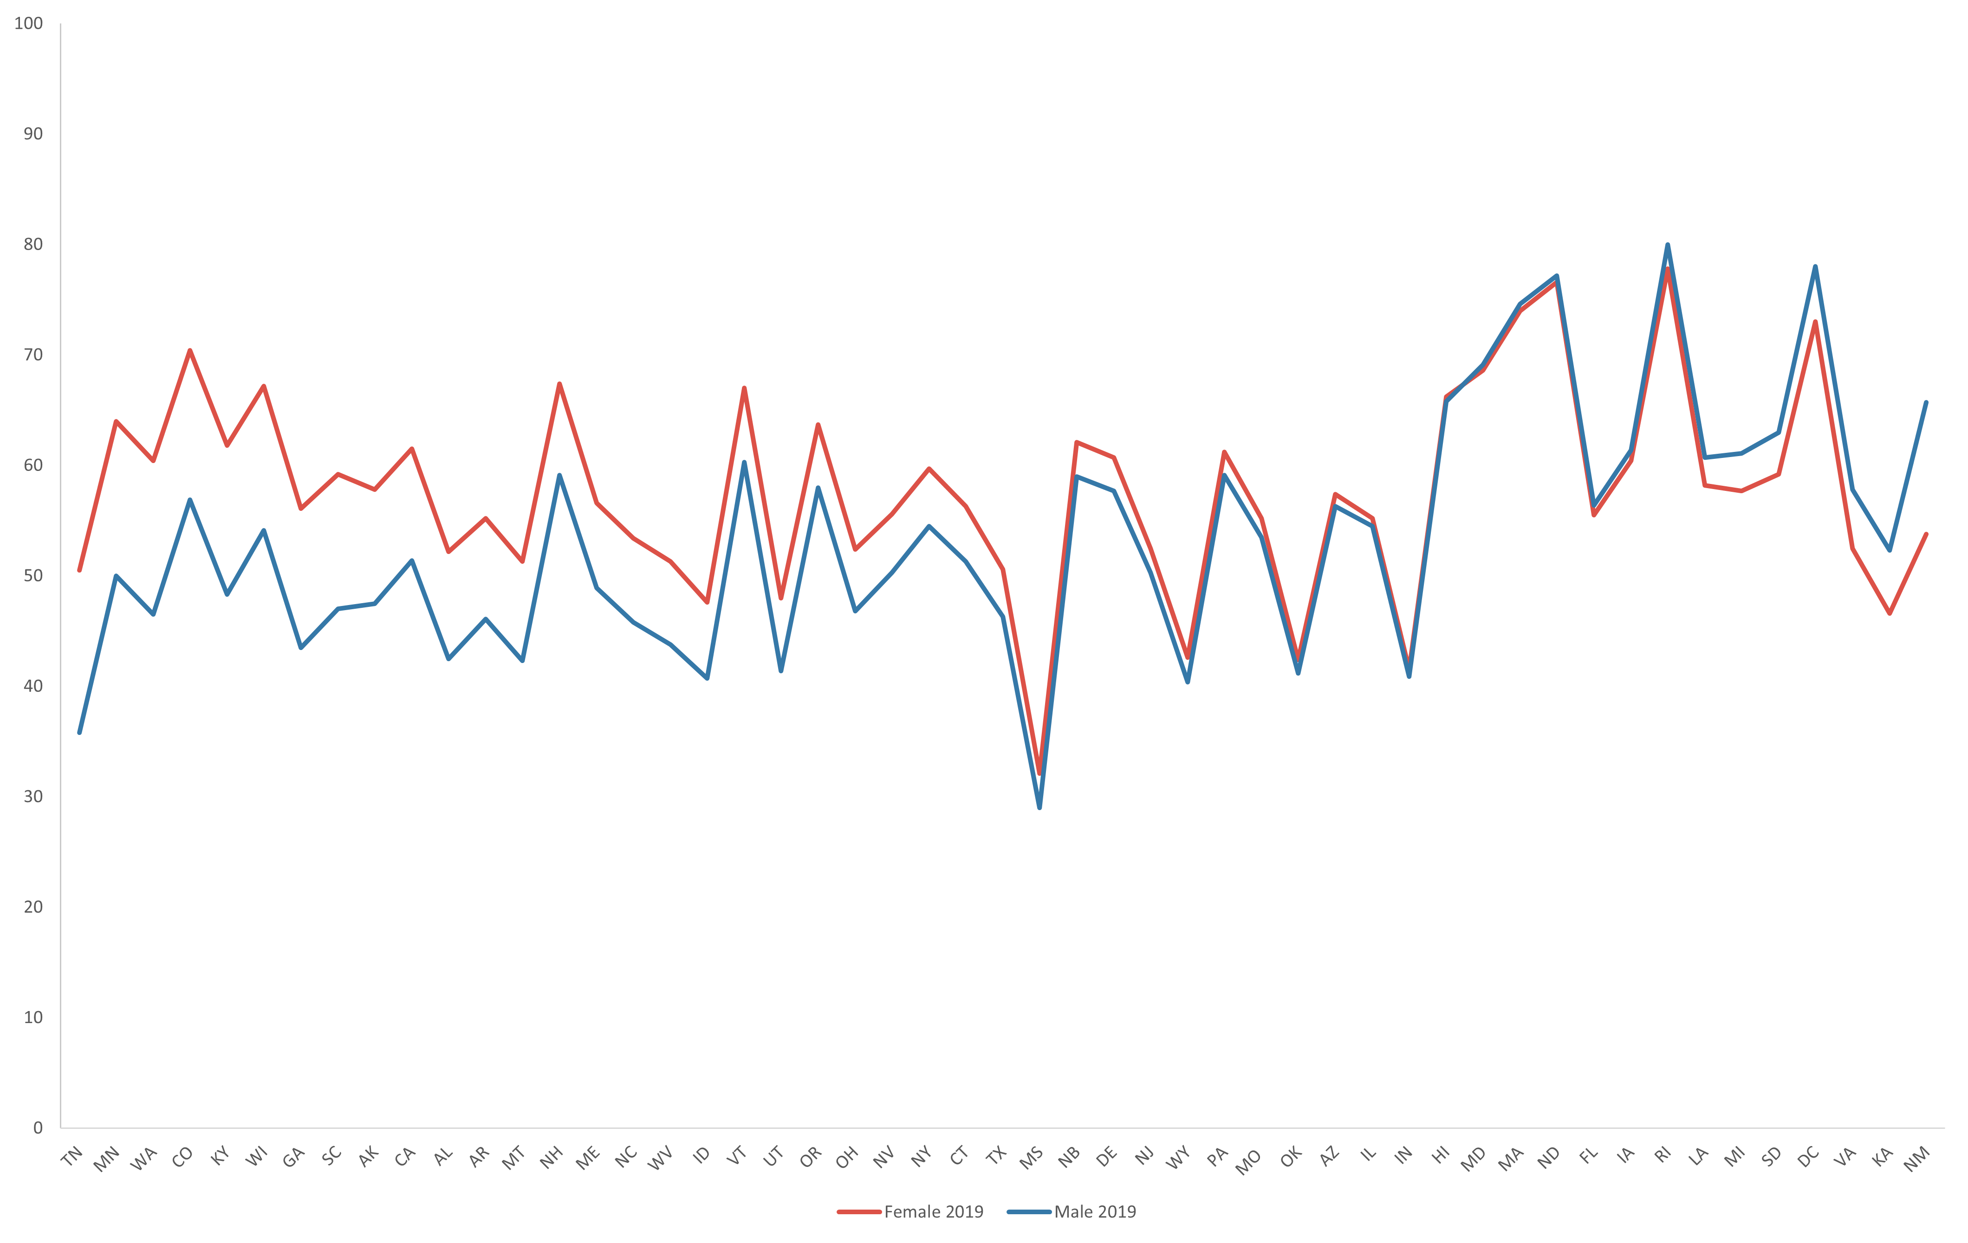
Vaccination Rates by Gender
Notes:
Last, but not least, this graph compares female and male vaccination rates from 2019 across different states and is sorted by the difference between those rates. Vaccination rates still tend to be higher for females than for males in most states, by about 4.25% on average. In some states, there is up to an almost 15% difference.

Slide 16
5.
Moving Forward

Slide 17
To Reach 80%...
Examine Successes
Increase Education Efforts
Address Barriers & Limitations
Keep Studying Data
Notes:
In order to reach our goal of annually vaccinating 80% of 13-year-olds, we should examine our successes, increase education efforts, address other barriers, and keep studying the data

Slide 18
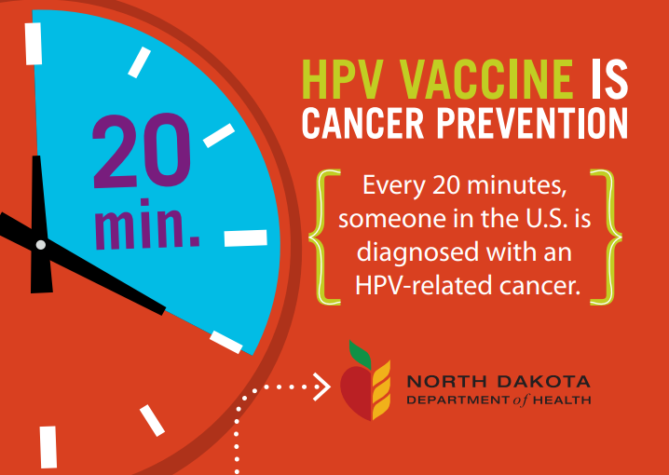
Examine Successes
North Dakota has the second highest vaccination rate in the country (~77%) despite being strongly Republican…
Why?
Notes:
Examining successes can help inform our future interventions with the most effective approaches – especially studying unlikely successes like North Dakota, which has the second highest vaccination rate in the country ( about 77% despite being strongly republican).
Potential explanations include the programs that they have in place. (i.e., postcards to parents, call to action to PCPs, lots of available info on the website directly aimed at parents and teens). The language they use in recommendations is also important (i.e., not describing it as being “optional” and including it in a list of other routinely recommended vaccines”)

Slide 19
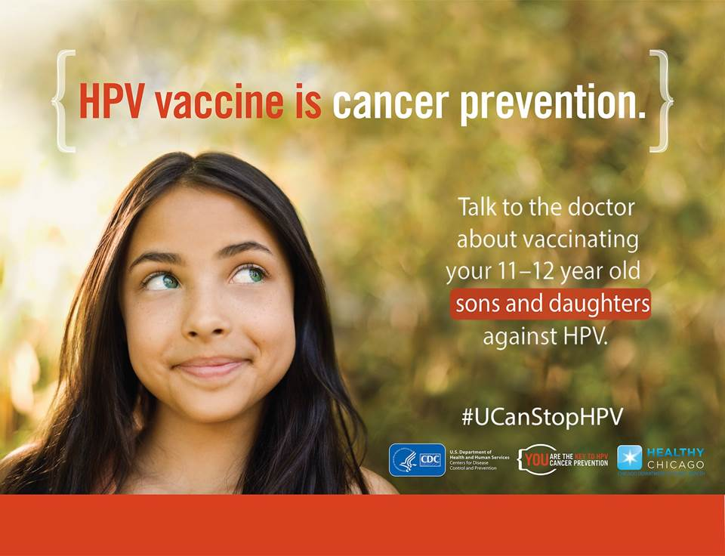
Increase Education Efforts
Change perception of the vaccine
Empower teens to make decisions about their health
HPV VAX NOW and other campaigns
Notes:
Address culture and perceptions of the vaccine through education effort
Connection to STD
Data presented shows that there’s still a discrepancy between female and male vaccination rates
association with being for females only/perceived lack of direct benefit for males -> need more education
Many resources (i.e., info sheets, movies like Someone You Love: The HPV Epidemic)
Social media campaigns have been successful in the past at positively influencing health behaviors (i.e., reducing smoking, usage of PrEP)
Campaigns already exist (Dept of Health and Human Services launched HPV VAX NOW for young adults) – just need to expand the audience and the types of information presented

Slide 20
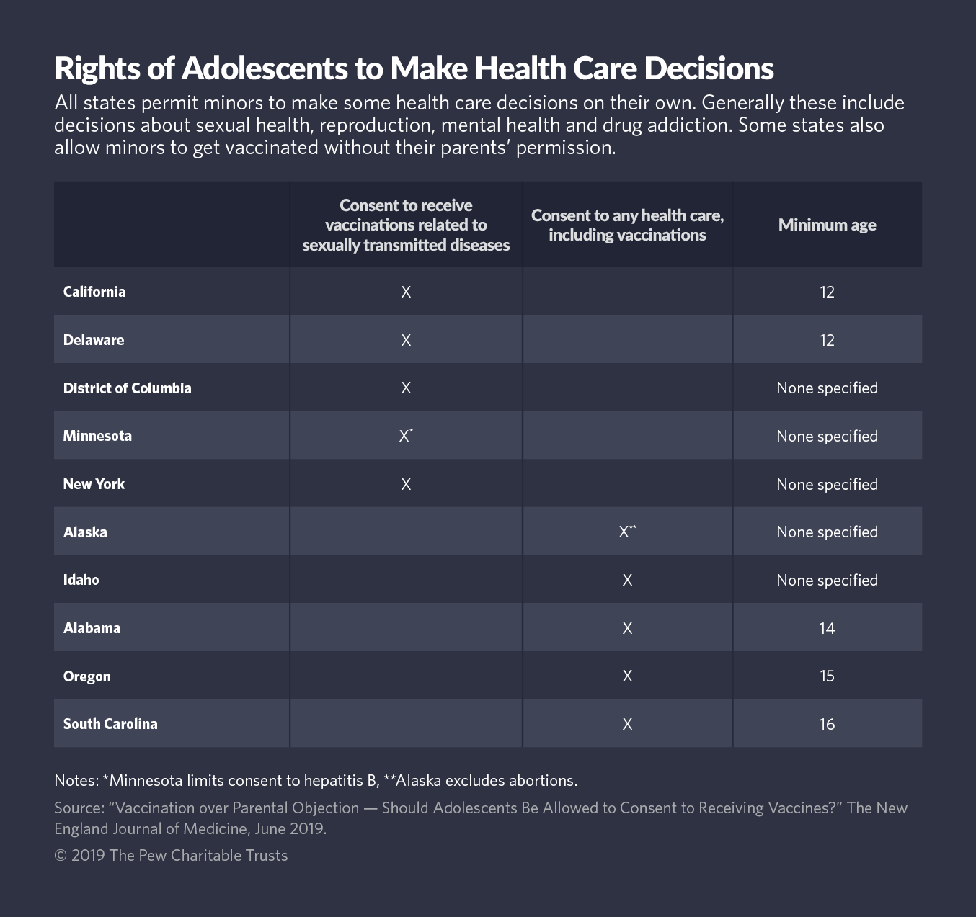
Address Barriers & Limitations
Parental consent
Lobby for more mandates and stronger mandates
Over-looked populations (i.e., homeschooled students, college students)
Notes:
We saw in the visualizations that financial concerns are not a major barrier… we need to consider and address other barriers to vaccination and the limitations of current interventions
Push for legislation to allow minors to get vaccinated without parental consent
The table on the right showcases the states which allow adolescents to make health care decisions without parental consent and the extent to which they are able to do so.
Lobby for school mandates in more states and improve current ones
Make sure mandates are for all genders
Stricter rules for exemptions
Target over-looked populations, i.e., adolescents who do not have a stable health care provider or have less access to information (e.g., homeschooled students who may not receive sex education and have access to a trusted adult other than their parents/guardians).

Slide 21
Keep Studying Data
Notes:
Finally, and most importantly, we need to keep analyzing new data as it comes in. It’s especially paramount for 2020 data – a year where outpatient care was greatly reduced (especially in person visits and thus vaccinations). 2020 is also an important year to look at in order to understand how the pandemic may have disproportionately affected HPV vaccine access for certain populations.

Slide 22
References
“American Cancer Society Logo.” American Cancer Society, American Cancer Society, 2021, cancer.org.
Angoluk, Eugene. “Four Covid19 Vials and An Injection.” Pexels.com, 18 Nov. 2020, www.pexels.com/photo/four-covid19-vials-and-an-injection-5922099/.
CDC – National Center for HIV/AIDS, Viral Hepatitis, STD, and TB Prevention – HPV Fact Sheet. https://www.cdc.gov/std/hpv/stdfact-hpv.htm. March 27, 2021.
Centers for Disease Control and Prevention. “HPV Vaccine Is Cancer Prevention.” Facebook, Hamilton County Public Health, 2019, www.facebook.com/HamCoHealth/photos/hpv-vaccination-provides-safe-effective-and-long-lasting-protection-against-canc/10156128158568652/.
Jones, Jeffrey M. “Democratic States Exceed Republican States by Four in 2018.” Gallup.com, Gallup, 23 Mar. 2021, news.gallup.com/poll/247025/democratic-states-exceed-republican-states-four-2018.aspx.
National Center for Immunization and Respiratory Diseases. National Immunization Surveys, 2018. Public-use data file and documentation. https://ndmsia.cdc.gov/IAS/data/excel?viewId=2233&geoId=17&subsetId=&viewer=Excel. 2021.
National Center for Immunization and Respiratory Diseases. National Immunization Surveys, 2019. Public-use data file and documentation. https://ndmsia.cdc.gov/IAS/data/excel?viewId=2279&geoId=17&subsetId=&viewer=Excel. 2021.
North Dakota Department of Health. “HPV Vaccine Is Cancer Prevention.” North Dakota Department of Health, 2016, www.ndhealth.gov/immunize/Documents/Recall/HPV%20Recall%20branded%20final.pdf.
Ollove, Michael. “Rights of Adolescents to Make Health Care Decisions.” The Pew Charitable Trusts, The Pew Charitable Trusts, 24 June 2019, www.pewtrusts.org/en/research-and-analysis/blogs/stateline/2019/06/24/teens-of-anti-vaxxers-can-get-their-own-vaccines-some-states-say.

